Slide 1

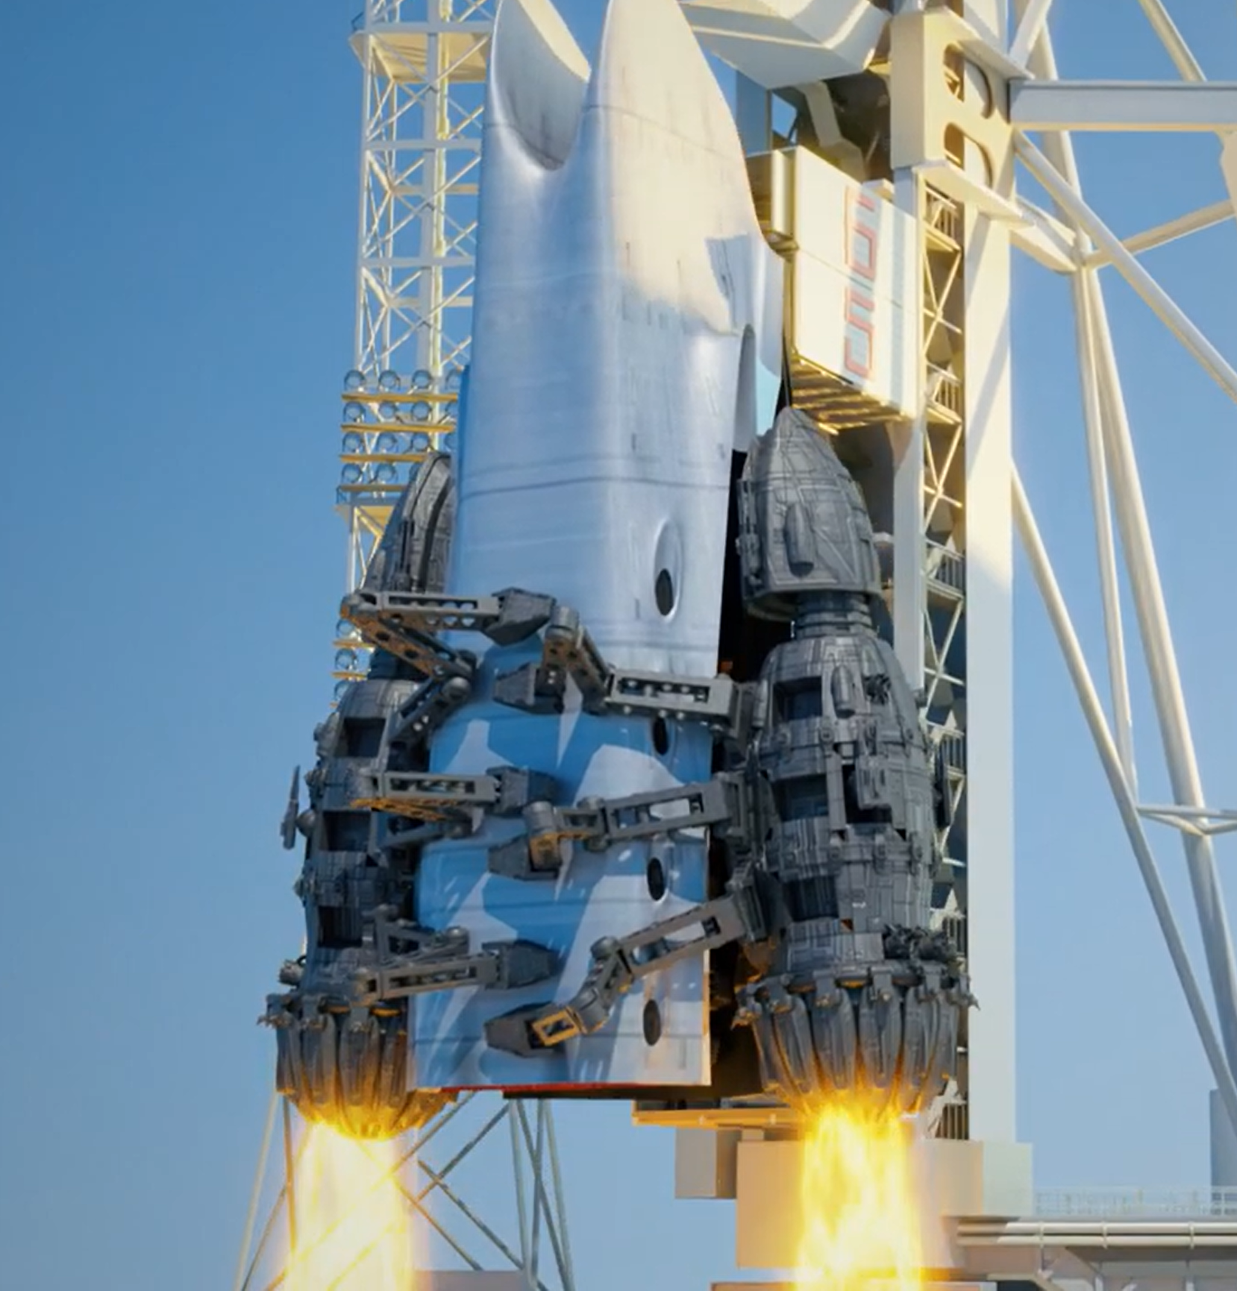


Herhofer Stargate Celleste Spaceport
Space Program
Herhofer Space Group
Global Galactic Business
Herhofer Space Research Institute
Herhofer Space University
Herhofer Stargate Spaceport

Slide 2

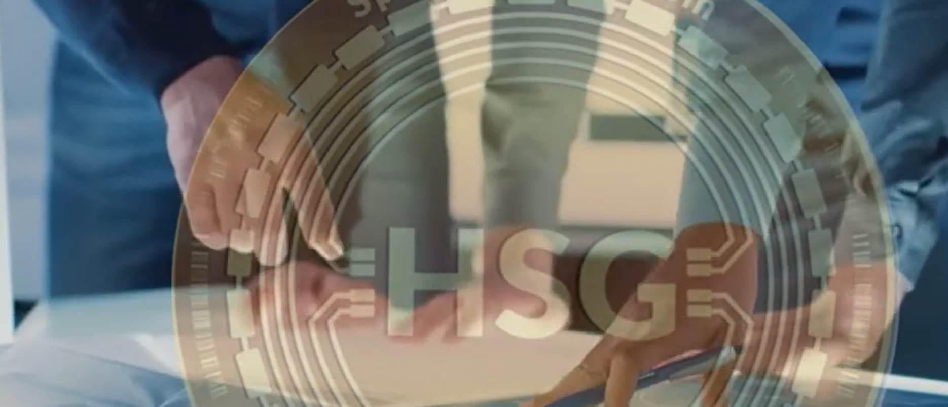
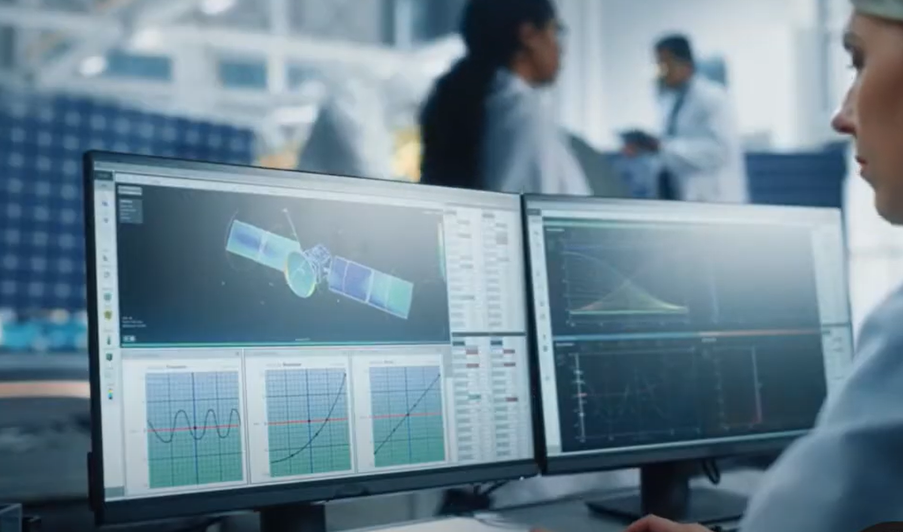

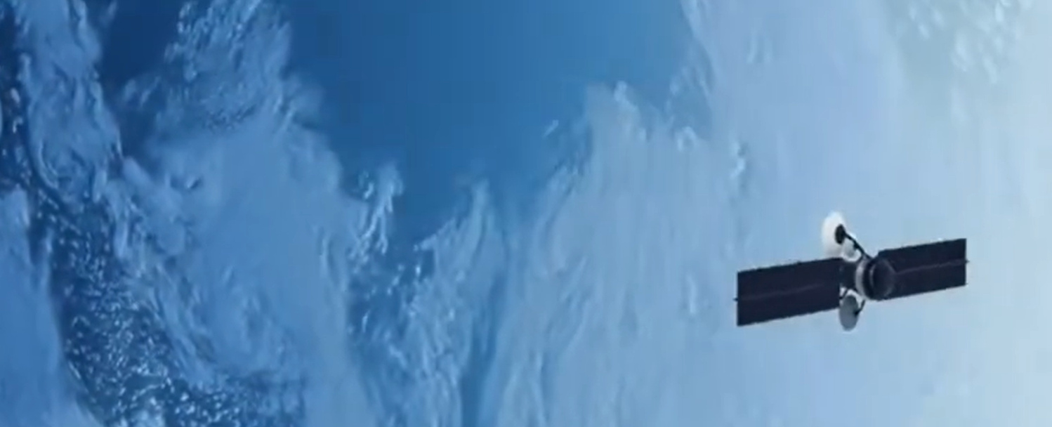
Planning the Process
Successfully delivered
Herhofer Stargate Celleste
Space Currency
Herhofer Net Worth
FCA Regulated LEGAL TENDER

Slide 3
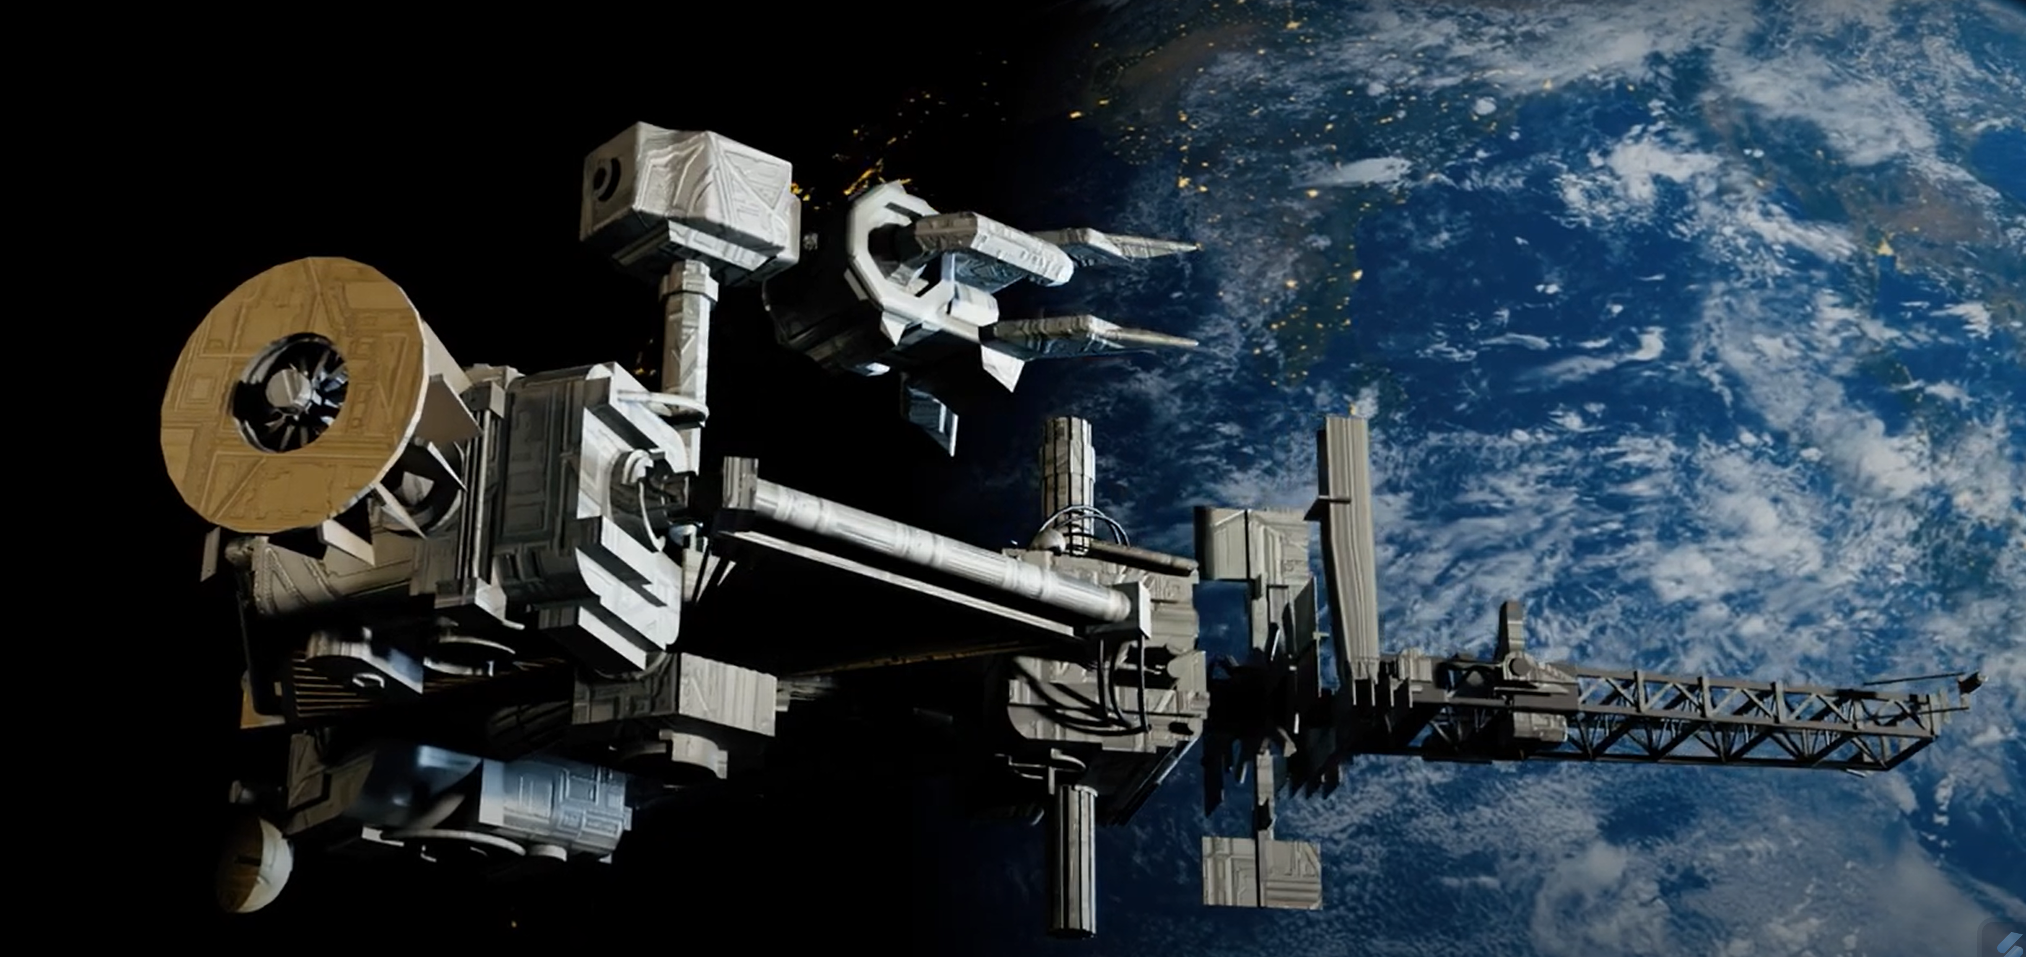

Herhofer Space Research InstituteTM
Herhofer Space University
Herhofer Space Bank
Orbital Construction Dock
Herhofer Stargate Spaceport
Herhofer Space Group
Herhofer Space Research Institute

Slide 4


Herhofer Stargate Celleste Space Program
Herhofer Space Education
Herhofer Orbital, Space and Interstellar Construction
Research and Development Herhofer Space Group
Herhofer Space Science

Slide 5
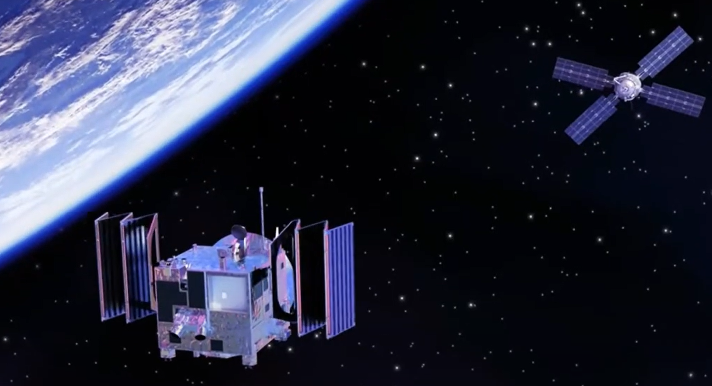
Thank you
L Herhofer, PhD
Space Mathematics
Herhofer Space University
space@herhofer.com
herhofer.com
herhofer.com/download
news.herhofer.com
edu.herhofer.com
research.herhofer.com
space.herhofer.com
finance.herhofer.com

